Slide 1


ENGINEERING DRAWING
Projection of Planes
Sheba Varghese
Assistant Professor,
Dept. Of Mechanical Engineering,
Room : A (310), KJSCE, Vidyavihar
Email : sheba@somaiya.edu

Slide 2
Projection Of Planes
Projection of planes:
Triangular,
Square,
Rectangular,
Pentagonal,
Hexagonal and
Circular planes
inclined to one reference plane and perpendicular to other

Slide 3


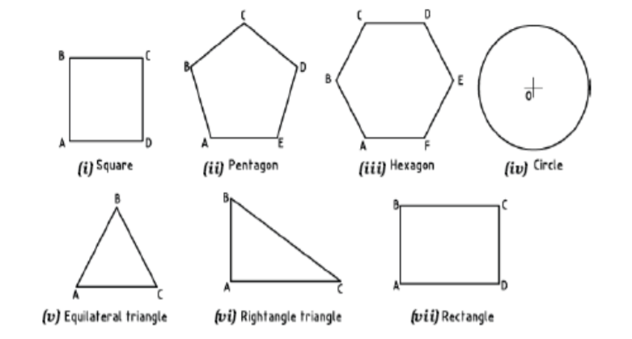


Planes
Two dimensional object having length and breadth only.
Its thickness is always neglected.

Slide 4
Construction of regular hexagon & pentagon - prerequisite

Slide 5


Note……
Data given in the question
Description of the plane figure
Its position with H.P & V.P
Data to find out
To locate T.V, F.V & S.V
How the position will be described w.r.t H.P & V.P
Inclination of it’s SURFACE with one of the reference planes will be given
Inclination of one of it’s EDGES with other reference plane will be given

Slide 6
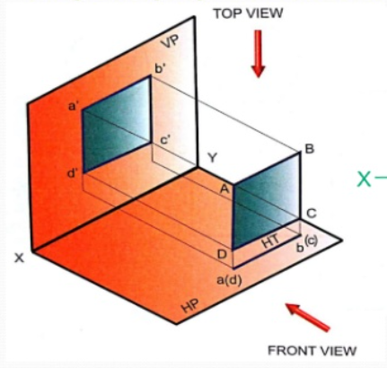
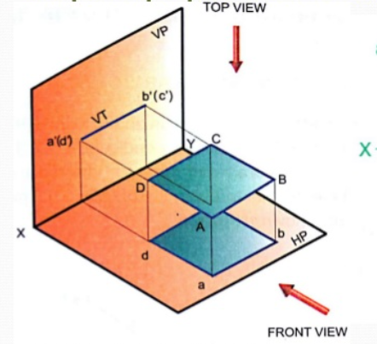

Slide 7
Trace of a Plane
Trace of a plane – Extension of a given plane shape to the reference plane (H.P or V.P) to which it is perpendicular or inclined.
The plane meets the H.P or V.P as a line
This line is called trace of a plane
Horizontal Trace (HT)
The line in which the plane shape meets the H.P is called HT
Vertical Trace (VT)
The line in which the plane shape meets the V.P is called VT

Slide 8
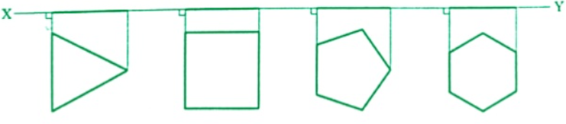
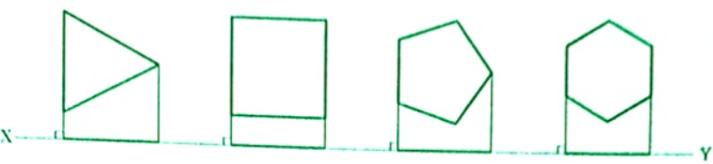
Simple Positions
Plane resting on one of its base side on H.P
Plane resting on one of its base side on V.P

Slide 9
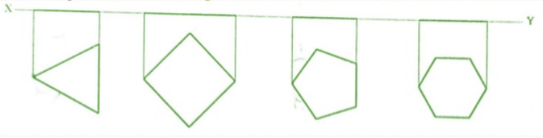
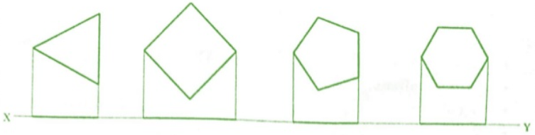
Simple Positions
Plane resting on one of its corner on H.P
Plane resting on one of its corner on V.P

Slide 10
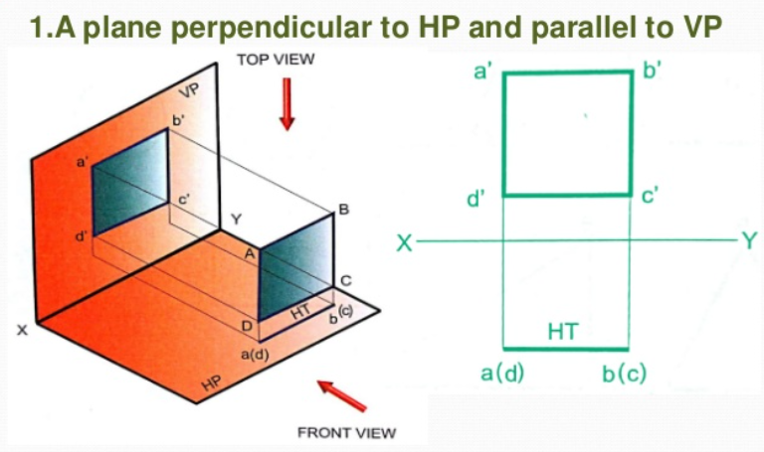
Plane perpendicular to HP parallel to VP

Slide 11
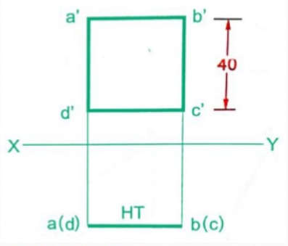
Plane perpendicular to HP parallel to VP
A square lamina ABCD of side 40 mm is perpendicular to HP and parallel to VP. Draw its projections

Slide 12
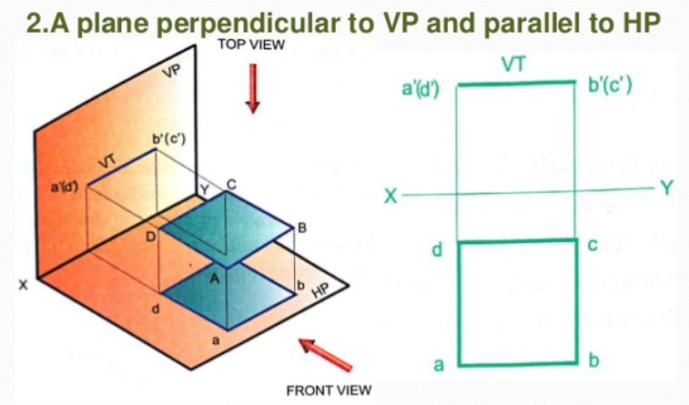
Plane perpendicular to VP parallel to HP

Slide 13
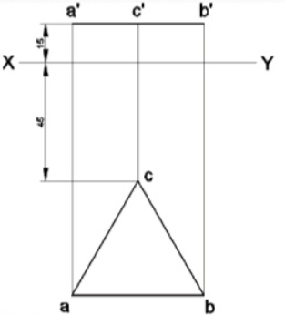
Plane perpendicular to VP parallel to HP
An equilateral triangle ABC of 50 mm side has its plane parallel to HP and side AB parallel to VP. Draw its projections when the corner C is 15 mm from HP and 45 mm from VP.

Slide 14
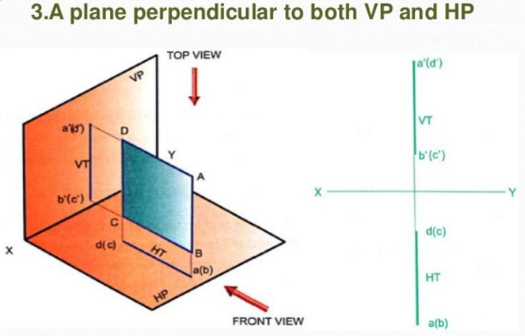
Plane perpendicular to VP and HP

Slide 15
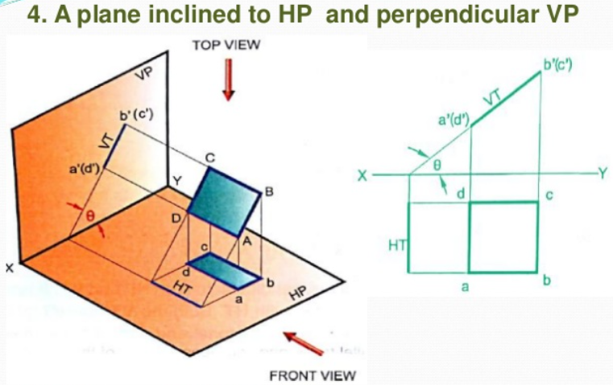
Plane inclined to HP and perpendicular to VP

Slide 16
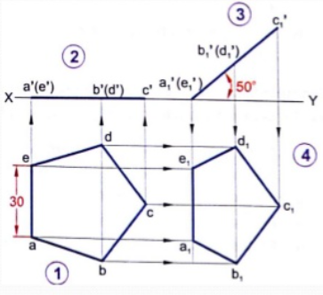
Plane inclined to HP and perpendicular to VP
A pentagonal plate of side 30 mm is placed with one side on the HP and the surface inclined at 50 ̊to HP and perpendicular to VP. Draw the projection of lamina.

Slide 17
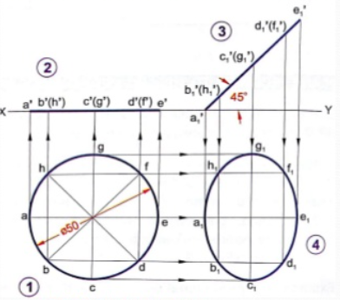
Plane inclined to HP and perpendicular to VP
A circular plate of diameter 50 mm is resting on HP on a point on the circumference with its surface inclined at 45 ̊to HP and perpendicular to VP. Draw the projection of lamina.

Slide 18
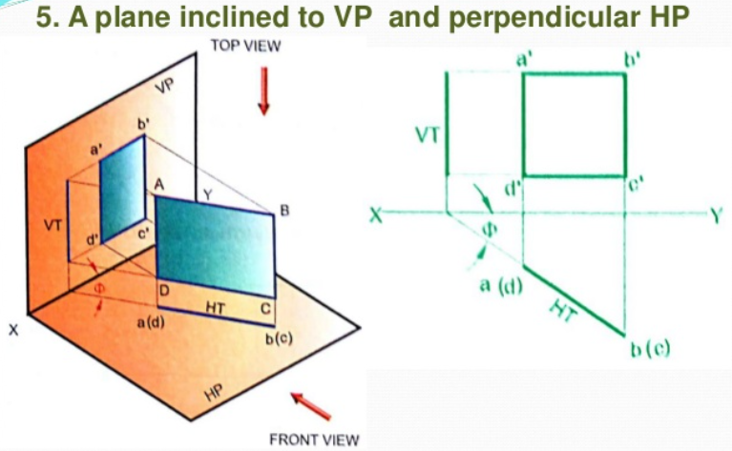
Plane inclined to VP and perpendicular to HP

Slide 19
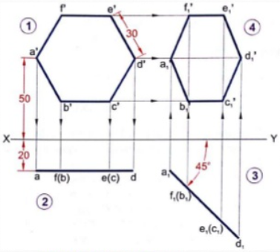
Plane inclined to VP and perpendicular to HP
A hexagonal plate of side 30 mm has a corner at 20 mm from VP and 50 mm from HP. Its surface is inclined at 50 ̊ to VP and perpendicular to HP. Draw the projection of lamina.

Slide 20
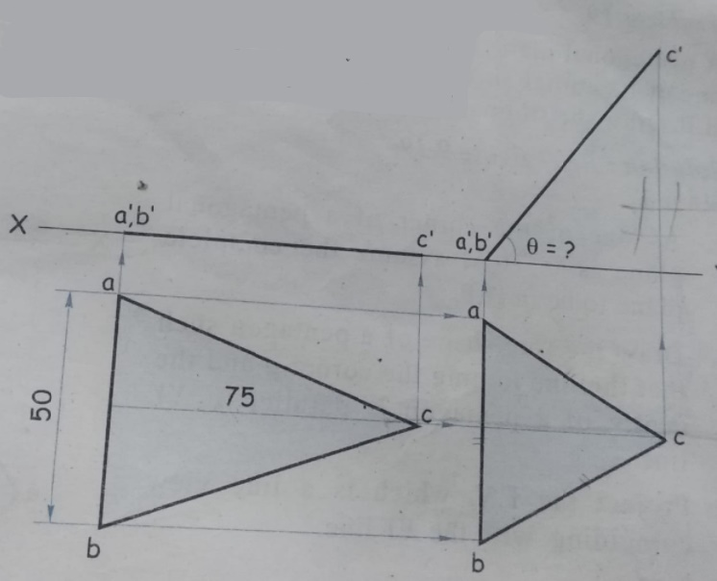
An isosceles triangular plate of 50 mm base and 75 mm altitude appears as an equilateral triangle of 5o mm in top view. Draw the projection of a plate if its 50 mm long edge is on the HP. What is the inclination of a plate with the HP?

Slide 21
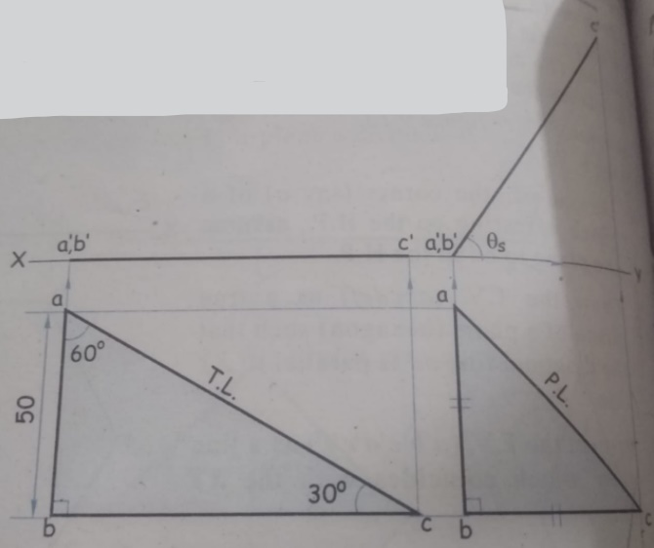
A 30 ̊- 60 ̊- 90 ̊ set square has its shortest edge 50 mm long and is in the HP. The TV of the set square is an isosceles triangle. Draw projections. Measure the inclination of a plane with the HP.

Slide 22
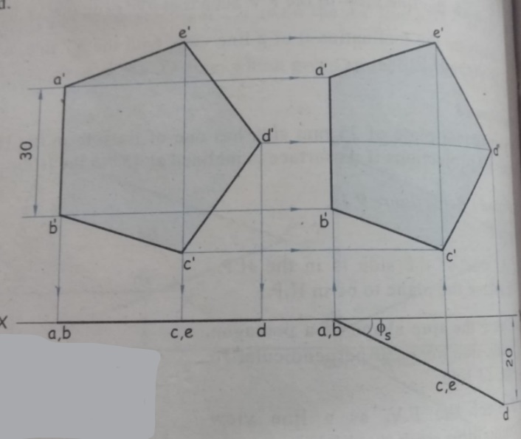
A pentagonal plate of 30 mm side has one of its side in the VP. The corner opposite to this side contained by the HP is 20 mm in front of the VP. Draw the projections and find inclination of a surface with the VP

